Slide 1
Capc kick-off meeting
Fall 2026

Slide 2
HOW CAPC WORKS

Slide 3
WHAT IS “CAPC”?
CAPC is the Curriculum and Academic Policies Council
CAPC is a faculty legislative body, the only such body with authority to recommend changes to (or creation of) the curriculum and/or academic policies
CAPC is a recommending body; the Provost has sole authority over the curriculum and academic policies

Slide 4
Why are we here?
…because CAPC is the curricular body mandated by the CBA (Article 31 section E):
  “There shall be a curriculum committee at each University, which shall be selected as determined by the FACULTY, but which may include at least one (1) administrator if designated by the President.”

Slide 5
Bylaws
CAPC is governed by a set of bylaws that lay out the committee structure, duties, and processes that comprise the foundation of CAPC’s work
The bylaws were updated last year; please be sure to download and review them (available on the CAPC home page), even if you’re not new to CAPC

Slide 6
Bylaws changes
Key bylaws changes (beyond general updating):
Clarification and specification concerning expectations of members (Article 4.B.1 and 4.B.2)
  New statement about avoiding conflicts of interest
Clarification regarding committee and subcommittee responsibilities in, e.g., course review and revalidation
Addition of appendices that include curriculum changes that also require review by local and state APSCUF (e.g., the local DE course policy vis a vis the CBA requirements)

Slide 7
How CAPC Works – org chart

Slide 8
Subcommittees – gen ed
Several CAPC committees have subcommittees:
General Education
  Distributed Disciplinary Foundations
  Diverse Communities
  Ethics
  Interdisciplinary
  Speaking Emphasis
  Writing Emphasis

Slide 9
Subcommittees – Arc & UGPC
Several CAPC Committees have subcommittees:
Academic Review
  Course Review and Revalidation
  Low Enrollment Advisory
  Course Delivery
  Program Review
Undergraduate Programs
  Culture Cluster

Slide 10
2026-27 CAPC Executive committee
  Chair: Susan Johnston, Anthropology & Sociology
  Vice Chair: Rodney Mader, English
  Secretary: Elizabeth Pfaffle, Applied Music
  Undergraduate Programs: Cristóbal Cardemil-Krause, Interim Vice Provost and Dean of University College
  Undergraduate Policies: Whitney Katirai, Health
  Graduate Programs & Policies: Marci Major, Interim Associate Dean of the Graduate School
  General Education: Karen Mitchell, Psychology
  Academic Review: Patricia Davidson, Nutrition
  CAPC Support: Patrick Richard, Academic Affairs

Slide 11
members
APSCUF runs elections for CAPC, which involve electing both at-large and department-specific members.
Members are elected to do the following:
participate in CAPC’s decision-making processes around curriculum and academic policies, through the committee structure
report back to their constituencies (department, college, etc.) about CAPC processes and actions
department-specific members also provide support and guidance for colleagues developing curriculum proposals for submission to CAPC, e.g., about learning outcomes, CIM, etc.

Slide 12
meetings
Participation in decision-making processes happens through:
work on committees and subcommittees
monthly CAPC General Assembly meeting where decisions are made on the proposals sent up by the committees
a commitment of 3-4 hours/week to do this work and availability for meetings on Thursdays, 3:30-5 during the semester

Slide 13
member duties
You should know your assigned committee(s) by now. If not, look on the ‘Committees’ tab of the CAPC website
Committees should meet on a regular schedule
Your service on CAPC includes attendance at both Assembly meetings and committee meetings
If you cannot attend, your proxy should attend on your behalf – applies to both Assembly and committee meetings
  The bylaws require all CAPC members to have a proxy identified and communicated to the CAPC Secretary in advance of meetings

Slide 14
Requirement for proxies
Article 4.A.1.c.
“Each CAPC member will submit to the CAPC Secretary written notification of that member’s proxy. In the case of members elected by constituency, the proxy must be selected from the same constituency. Proxies should be identified no later than the first scheduled Assembly in the fall. Should the proxy require an alternate, the proxy or member should notify the CAPC Secretary in writing prior to the Assembly in which the alternate is to serve. It is the responsibility of the member to see that their proxy attends the Assembly and relevant (to the member’s assignment) Committee meetings, if the member is unable to attend.”

Slide 15
capc service: preparation
Your service on CAPC also includes the following:
preparing for committee and sub-committee meetings by reading in advance and reflecting on all documents on the agenda
preparing for CAPC Assembly by reviewing in advance those items on the agenda that did not come from your committee
ensuring that you are fully acquainted with the current requirements for course and program proposals, including the relevant policies (syllabus and course evaluations, assessments, etc.)

Slide 16
CAPC service: reporting
Your duty as a CAPC member is also to inform your constituency; this means reporting back to them about CAPC Assembly and its procedures, debates, and recommendations:
CAPC decisions about courses, programs, or policies that may have impact on your department (or your other constituencies), whether or not they originated in your department or college
Let them know when an item of theirs appears on the Assembly agenda and remind them that they are invited to attend the relevant assembly meeting to respond to questions that might arise

Slide 17
Capc service: representation
Your duties as a CAPC member also include representing your constituency’s views:
  In assembly ‘floor’ discussions about motions under consideration
  In the ‘Updates from Departments’ portion of the agenda (under Continuing Business); this is a good place to let us know about items under discussion in your department (or other constituency)

Slide 18
CAPC service: conflicts of interest
Members must avoid conflicts of interest
Expected to recuse themselves from consideration of and voting on proposals for which they participated* as developer or reviewer prior to the proposal entering CAPC review
  *As preparer, member of department committee, chair or director, role in dean’s office
  Does not include advice offered to colleagues as part of the member’s CAPC role

Slide 19
Proposal progression
NOTE:
When a committee sends an item forward for the Assembly agenda, it is with that committee’s support (unless explicitly stated otherwise).
Similarly, when a department chair, dean, or CAPC officer ‘signs off’ on a proposal in CIM, it indicates support (not simply acknowledgment)

Slide 20
Recommend/not recommend
NOTE:
That said, deans may assume they are leaving curricular decisions to the departments and to CAPC, and are only approving the availability of resources and other non-curricular issues
In fact, a decision at each step in the review process is to recommend (or not recommend), since final approval rests with the Provost

Slide 21
Provost decision
Motions passed by CAPC are submitted to the Provost for approval
There is a procedure for dialogue in the event that the Provost does not approve CAPC recommendations (this is a rare occurrence)
The Provost’s approvals are circulated by Patrick Richard and are available on the CAPC website.

Slide 22
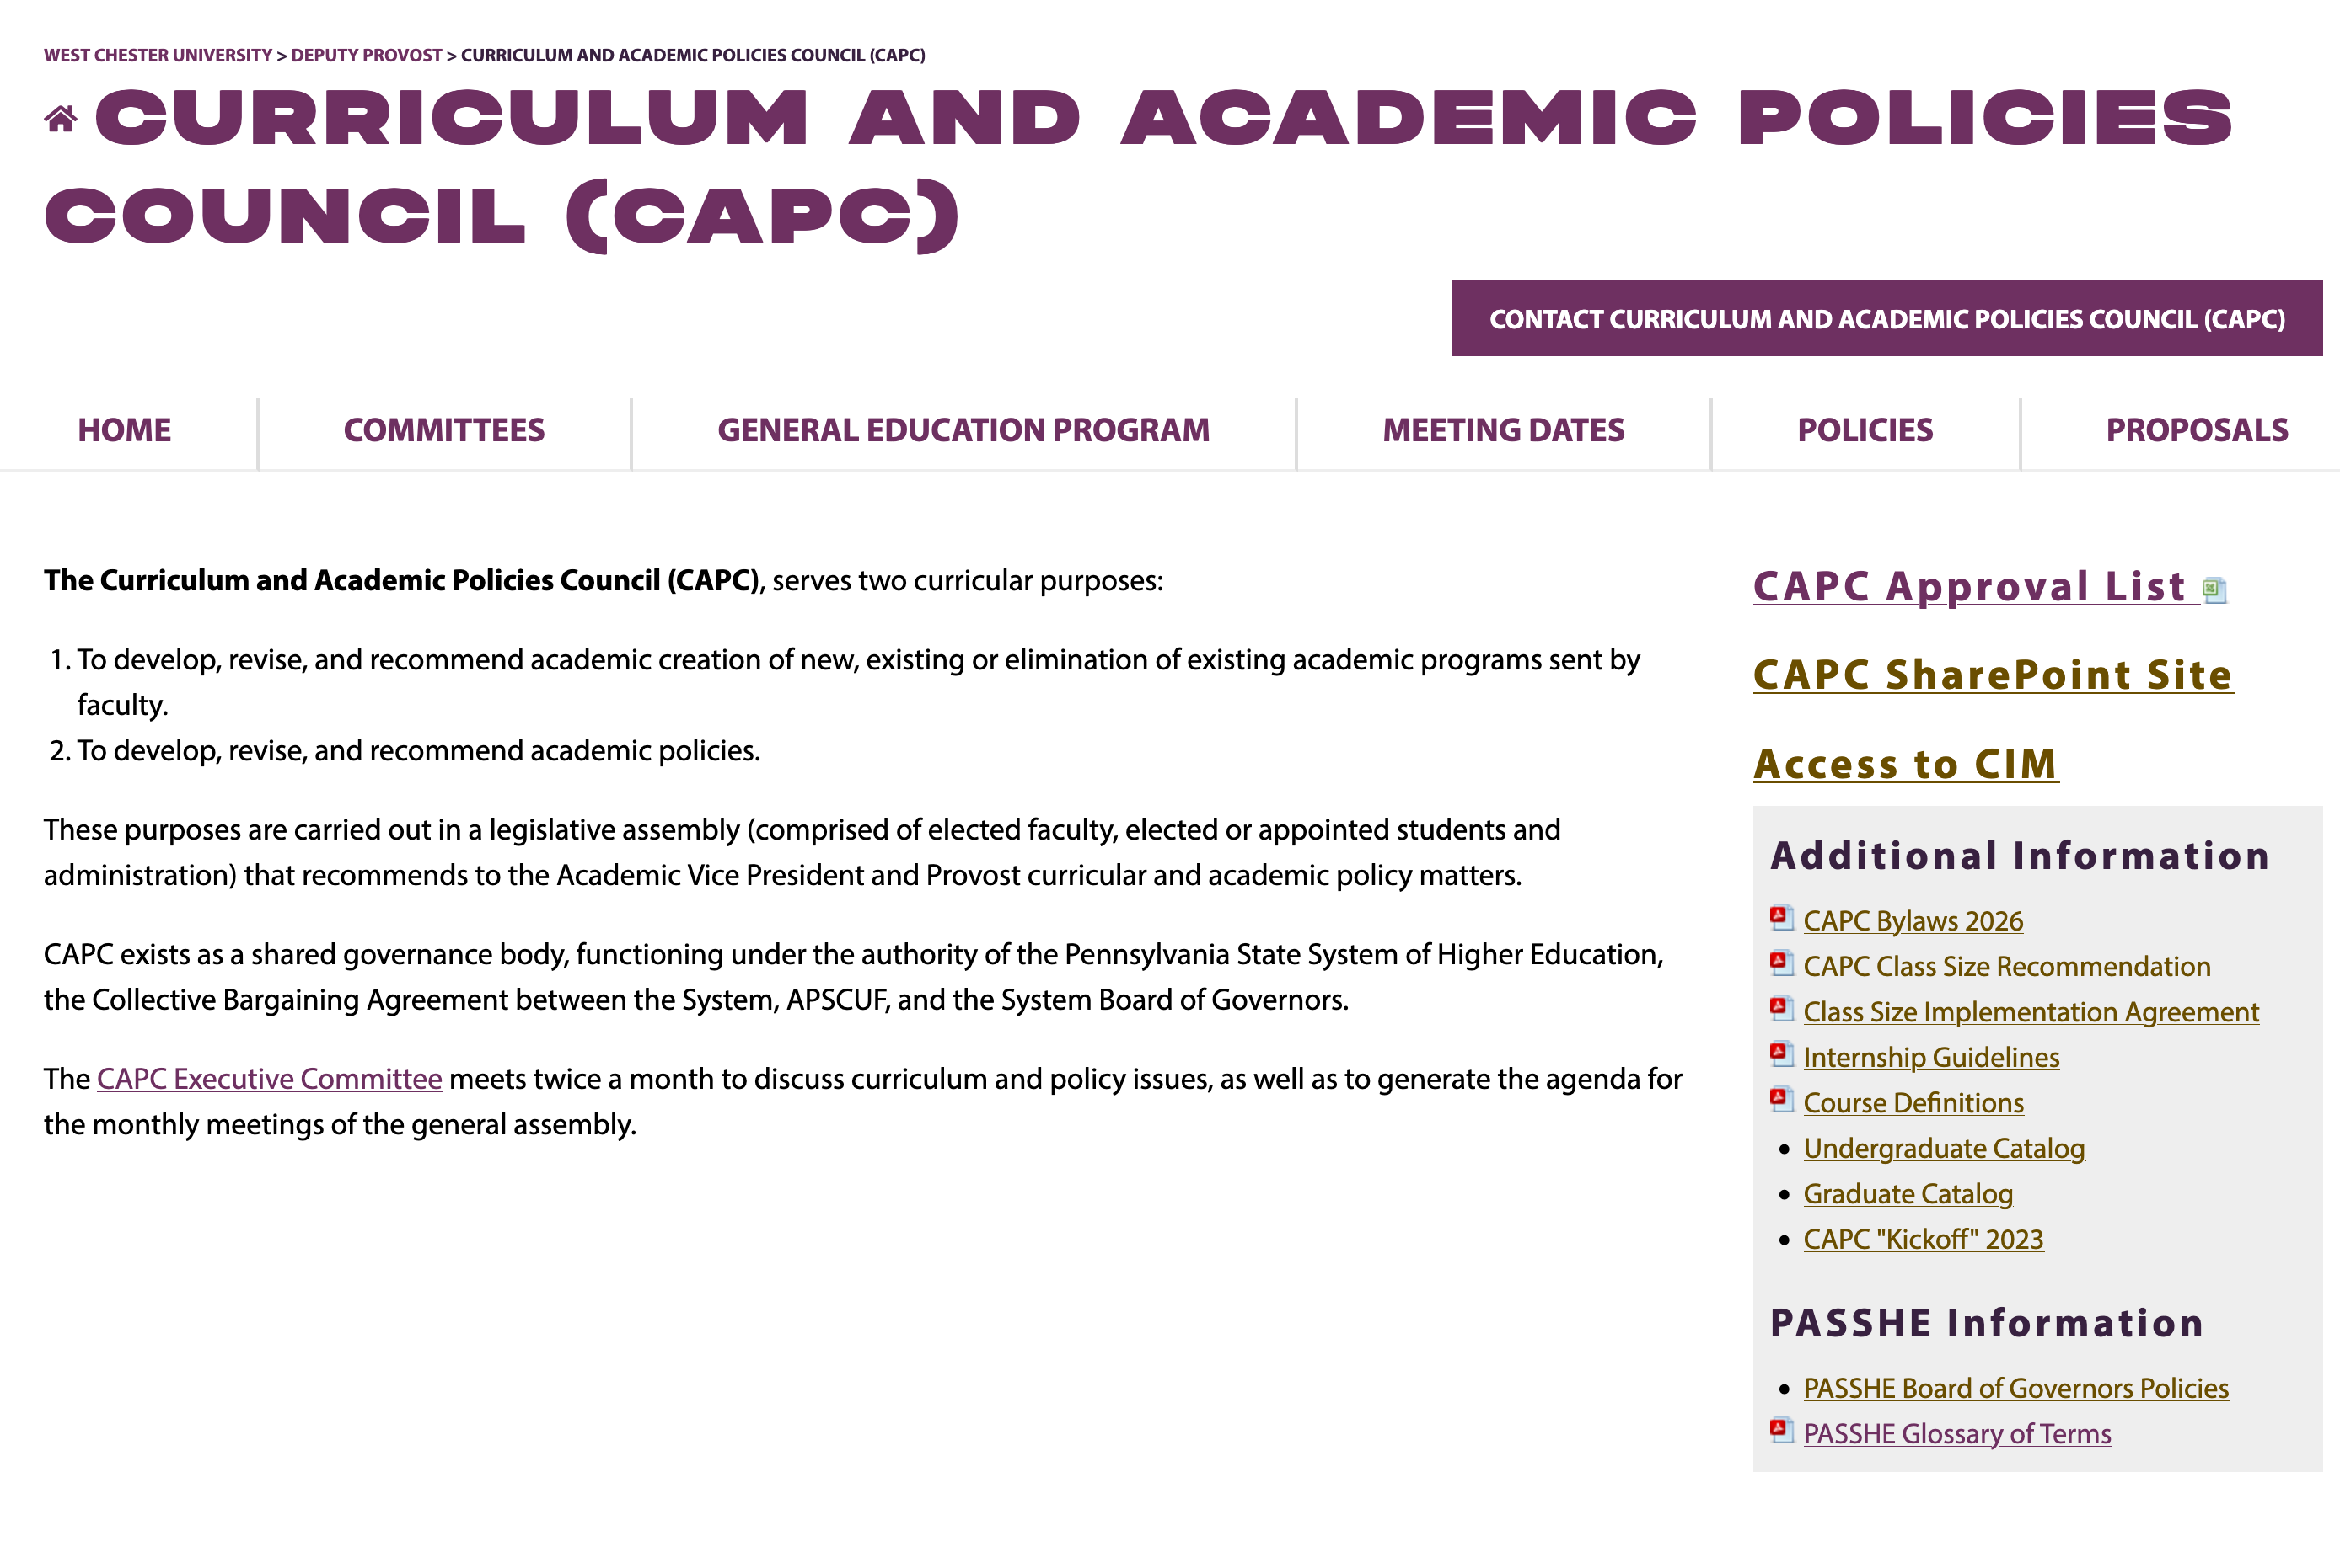
CAPC website

Slide 23
REMEMBER…
In summary:
CAPC is a contractually mandated representative body that gives faculty significant control over the curriculum
  At WCU, this body represents a stronger and more effective role for faculty than is the case at many other institutions, including some in PASSHE
  As CAPC representatives, we have an obligation to responsibly carry out our mandate on behalf of the faculty and departments we represent

Slide 24
Course inventory management (CIM)

Slide 25
CIM: Course inventory management

Slide 26
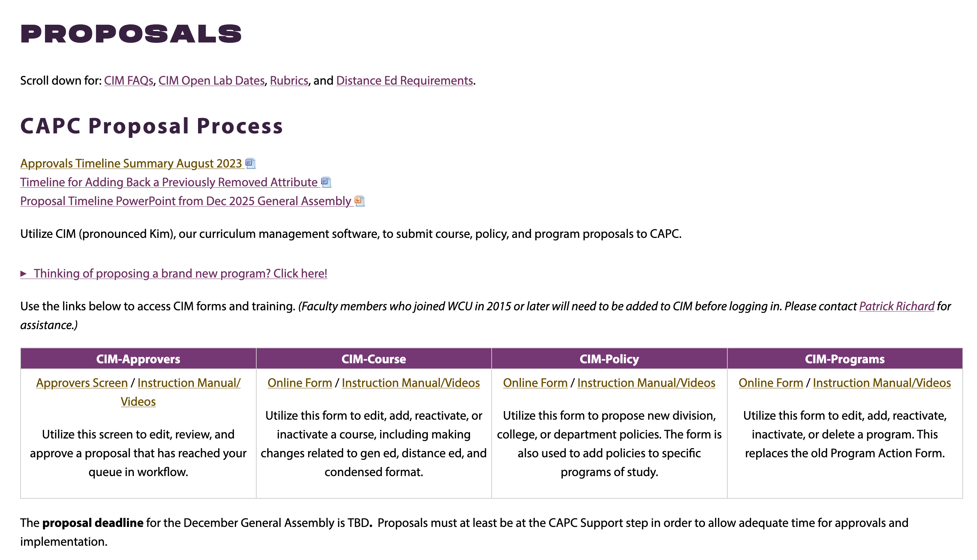
PROPOSALS PAGE

Slide 27
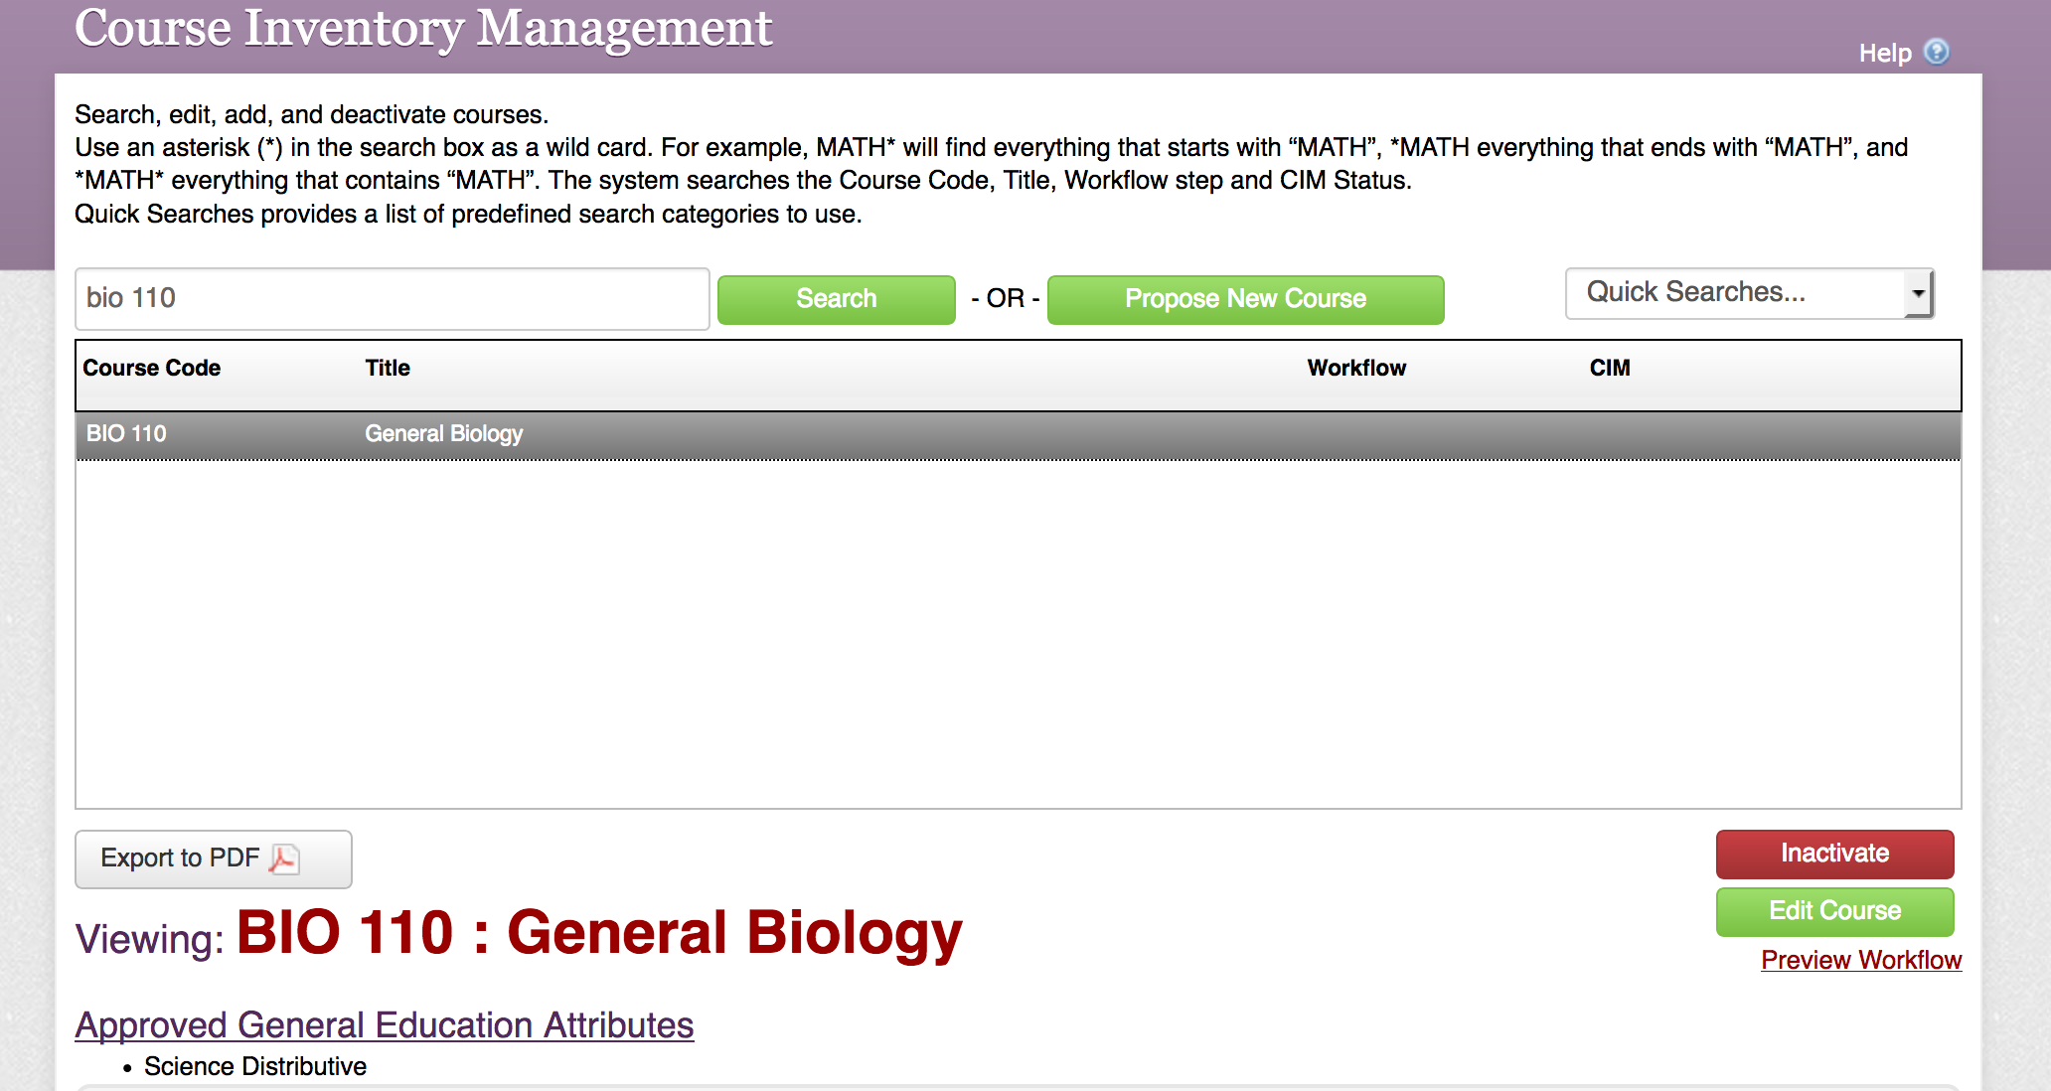
COURSE INVENTORY ACCESS

Slide 28
CIM APPROVERS ACCESS

Slide 29
PROPOSAL REVIEW: FIND YOUR APPROVER ROLE

Slide 30
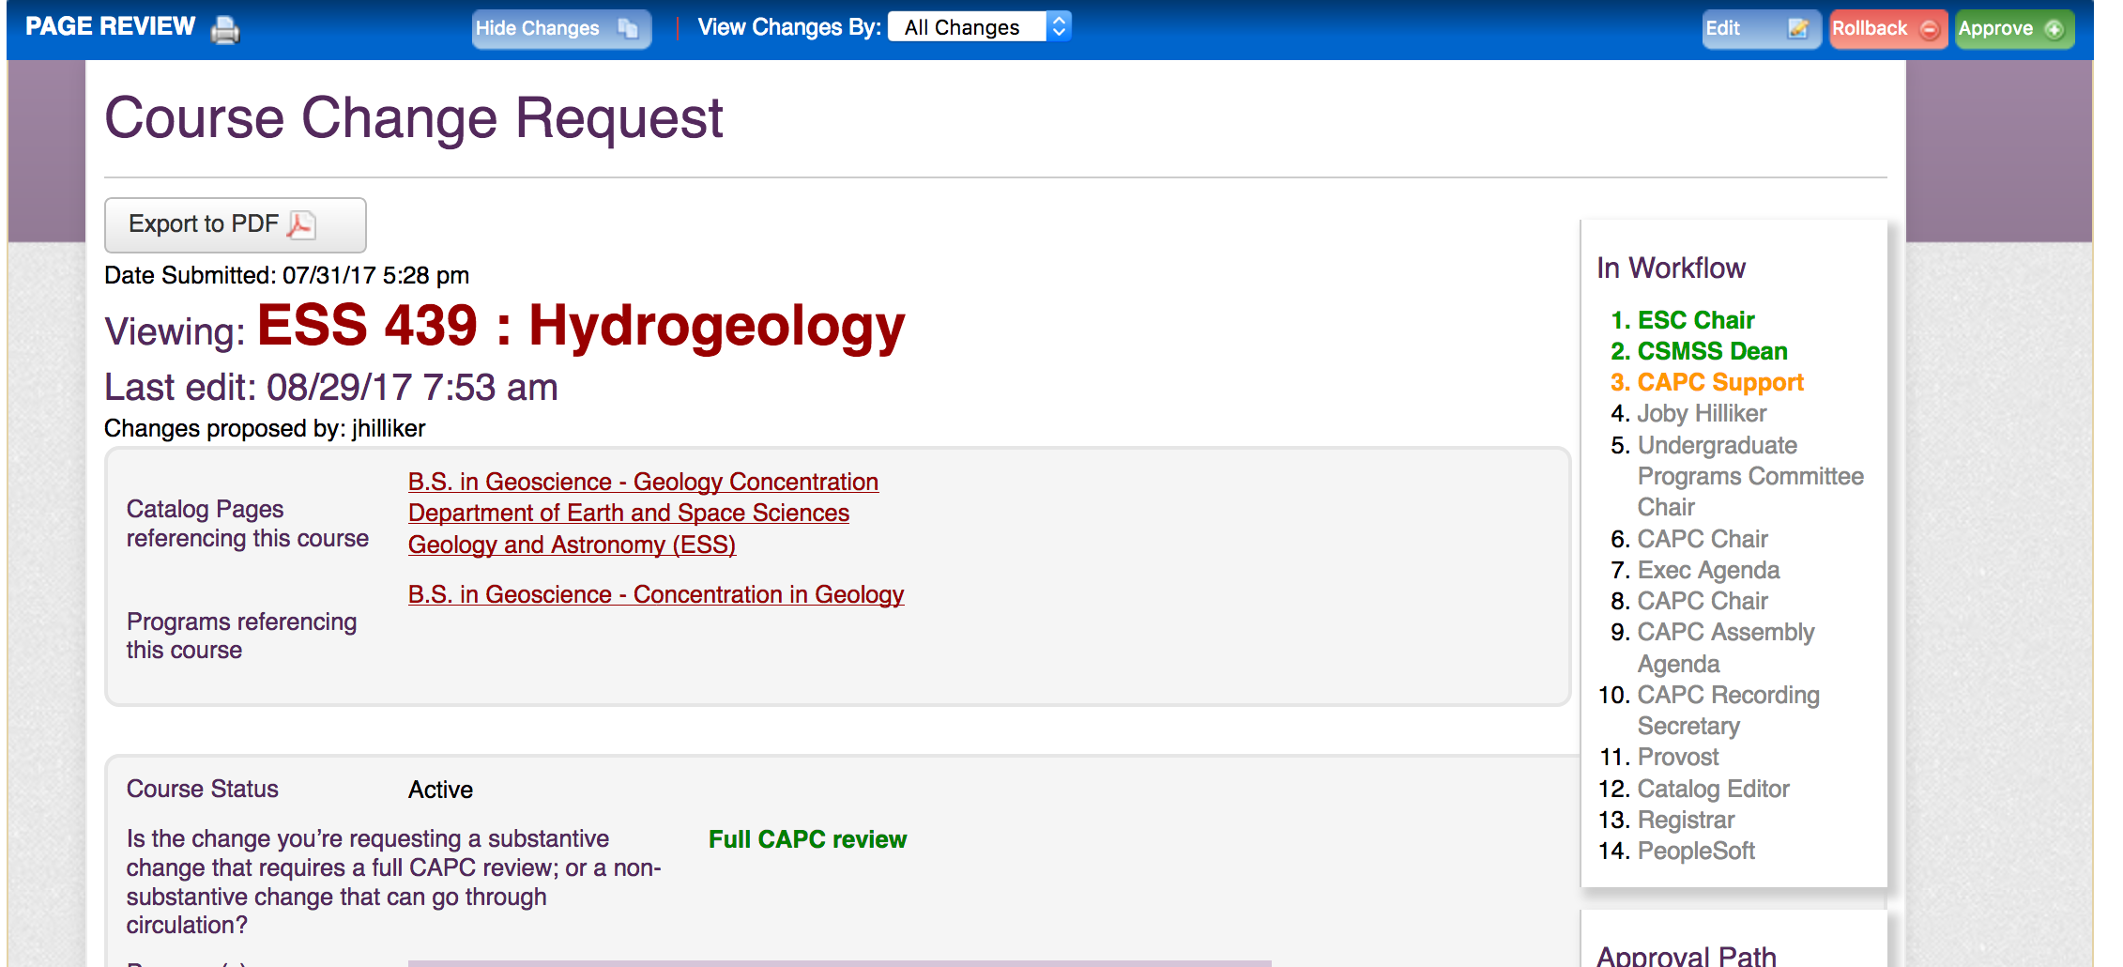
PROPOSAL & WORKFLOW VIEW
Note: Email notifications (approval requests & notifications) come from “CourseLeaf”

Slide 31
Cim instructional information

Slide 32
Support for proposal development and cim
Due to low demand the last couple of years, we are not holding open labs this fall. However, we are happy to help via one-one discussion.
For questions about CIM: contact Patrick Richard
For curriculum/proposal development questions: contact Sue Johnston

Slide 33
Approvals timeline

Slide 34
Approvals timeline information

Slide 35
Approvals Timeline overview
Summarizes criteria determining the effective date (the earliest implementation semester) of course and program proposals
Relevant factors:
  Nature of the proposed change (is it expansive or limiting/restrictive in its impact on students)
  Catalog cycle
  Registration cycle for subsequent semesters
  ‘Truth in advertising’ to students and prospective students

Slide 36
Timeline: Program Changes
Program changes that limit curricular options, or change requirements, for students
Examples: elimination of a program/concentration; additional course requirement(s); degree change (e.g., BA to BS); additional prerequisite requirements that are not already reflected in the course list.
Such program changes should be approved in enough time to be advertised (e.g., via the catalog) to new students admitted to the program (typically one year in advance). For example, for the Fall 2027 implementation cycle, changes would need to have been fully approved by May 2026.

Slide 37
Timeline: Program Changes
Program changes that expand curricular options for students
Examples: addition of a new track; new course options to meet requirements; creation of a new non-degree program (e.g., a certificate)
Such program changes should be approved as soon as possible but not later than December of the year prior to implementation. For example, expansive program changes intended for Fall 2027 implementation would need to be fully approved by the December 2026 assembly.

Slide 38
Timeline: Course Changes
Course changes that reduce or significantly impact student options
Examples: adding/removing general education attributes; additional/edits to prerequisites; substantial description changes; credit change; creation of a newly required course
Such changes need to be made prior to the start of course registration for a given semester. Given how early this process begins each semester, changes would need to be approved a year in advance, i.e., by the end of the same semester in the prior year. For example, changes for spring 2027 would need to have been approved by May 2026 to be available to students at the start of the fall registration period for Spring 2027.

Slide 39
Timeline: Course Changes
Course changes that expand accessibility or flexibility of courses, providing addition options to students
Examples: additional modality options, minor changes in course description
Such changes would not require an extended proposal timeline. However, course changes should be fully approved before the course registration period for the implementation semester. For example, changes for Spring 2027 should be approved by the end of September 2026 to be available for course registration beginning in October. It should be noted that in many cases such changes can go through Circulation.

Slide 40
Proposal ‘Effective Dates’ Summary (2026-27)
Program changes that impose new requirements or limit student choices had to have been approved by May 2026 for Fall 2027 implementation; now targeting Fall 2028
Program changes that are expansive in nature (e.g., add new options for students) have to be approved by December 2026 for Fall 2027
These timelines keep our proposal approval/implementation process aligned with the academic catalog
Reminder: Course changes generally need to be approved and built in time for the registration cycle for the desired implementation semester

Slide 41
Proposal effective dates summary (cont’d)
Accordingly:
Course changes for Winter or Spring 2027 that can go through Circulation (e.g., additional modality) must complete that process by the end of this September
Course proposals for Summer or Fall 2027 implementation must be recommended by February 25, 2027 (first CAPC assembly in spring) in order to be available for the registration period for those terms

Slide 42
Recent updates & Efforts for this year

Slide 43
Priorities and efforts this year
General Education and General Requirements
Finalizing the Diverse Communities (DIV) revalidation process
  All outstanding DIV courses should be in CAPC workflow now, or within the next month, to ensure approval this semester and avoid removal of the attribute.
Interdisciplinary (INT) course revalidation is this year
  First revalidation of INT since the implementation of Gen Ed 2019 goals & SLOs
  ALL INT courses must be submitted, regardless of whether they were reviewed since 2019 for other reasons (e.g., DE)

Slide 44
Efforts this year (cont’d)
General Education (continued)
General Reminder: Gen Ed and General Requirement courses that come through the proposal review process, regardless of reason, will be reviewed under the current GE goal and SLO structure
Academic Policies
Continue work to update and organize Undergraduate and Graduate academic policies in accessible formats

Slide 45
Questions?

