Slide 1
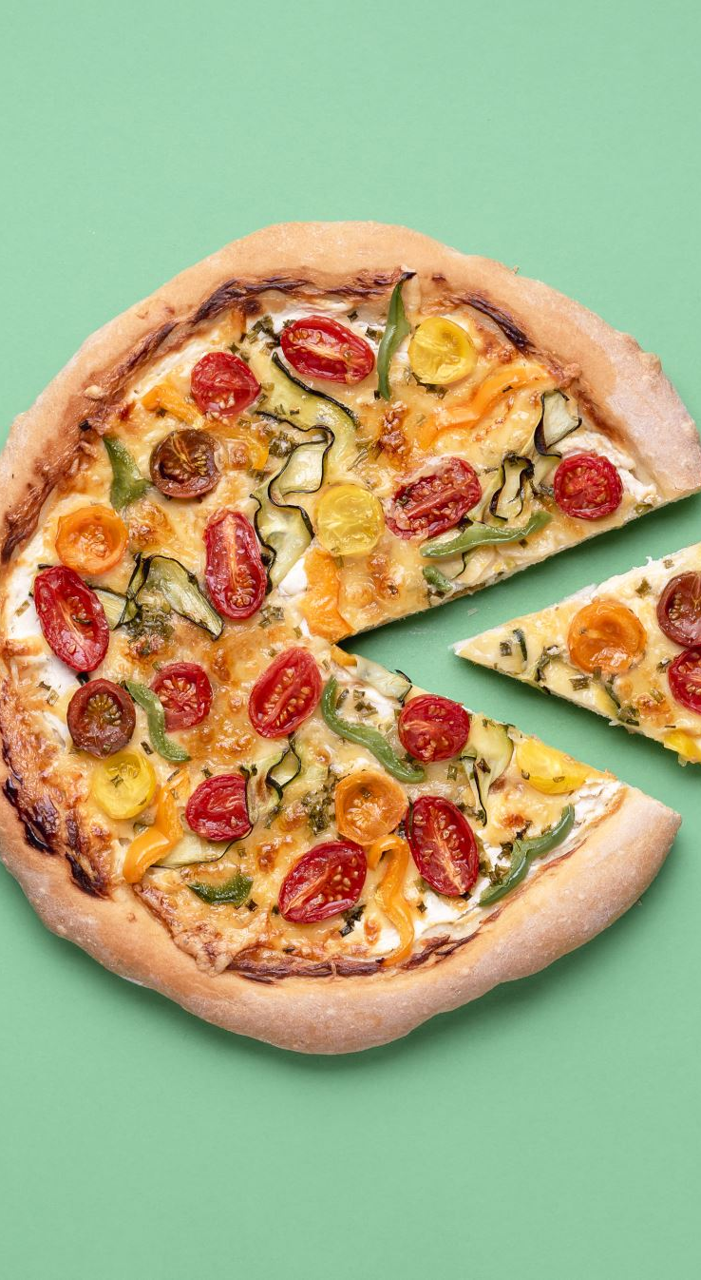
SAVE THE DATES!
Philosophy Events: Spring 2025
Saturday, Feb 1 High School Ethics Bowl
Tuesday, Feb 13 Guest Speaker
Friday, April 4 Grad Student Conference
Wednesdays 3-4 ‘Phika’ Coffee & Sweets

