Slide 1
Treasurer Training
West Chester University of Pennsylvania

Slide 2
Learning Objectives
Through the Officer Training Seminar, officers will gain…
Understanding of best practices to use in leading within positions
Understanding of officer role and responsibilities
An ability to locate particular knowledge on how to access and utilize pertinent campus resources

Slide 3
Role of the Treasurer
SGA Blank Bylaws
The duties of the treasurer shall be:
  To manage the monies of the organization
  To attend the annual SGA budgeting seminar meeting, held in the fall of each year
  Be a voting member of the organization
  To preside over meetings in the absence of the president and vice president

Slide 4
Important Documents Relating to Role
Student Government Association Student Organization Policies and Procedures
Student Government Association Bylaws
Student Government Association Financial Policies and Procedures
Ram’s Eye View Student Handbook
Student Services, Inc. Policies and Procedures
University Program Planning Guide

Slide 5
SGA Financial Policies and Procedures

Slide 6
Section A: Eligibility for Membership and Funding

Slide 7
SGA Financial Policies and Procedures
Section A: Eligibility for Membership and Funding
Club/organizations’ membership shall be limited to persons who are members of the Student Government Association as defined as a full-time or part-time SSI fee-paying students.
Clubs/organizations that practice exclusion cannot be budgeted by SGA. Exclusion shall be defined as voting by the current membership to extend invitations for future membership.
Clubs/organizations defined by the Office of Student Leadership and Involvement as “Greek Letter Organizations,” or “Honor Societies” shall not receive budgeted funds from SGA, with the exception of Greek Governing Councils. In addition, “Service Organizations” which practice exclusion shall not be budgeted.

Slide 8
Section B: Budgeting Process

Slide 9
SGA Financial Policies and Procedures
Section B: Budgeting Process
The Budgeting process for all organizations begins in the Fall semester and will be covered in greater detail by the Fall SGA Budgeting Seminars. For the purpose of this training seminar, here’s what you need to know now about the organization budgeting process...

Slide 10
SGA Financial Policies and Procedures
Section B: Budgeting Process
To be eligible for funding, SGA funded organization treasures must attend the annual mandatory SSI treasurer training (Attending this Seminar today satisfies this requirement) and SGA budgeting seminars. Failure to attend these seminars, unless excused by written consent of the SGA treasurer or executive director of SSI, will result in an organization becoming ineligible to receive funds for the next fiscal year (Section A: Eligibility for Membership and Funding).
To receive consideration for funding, the club/organization must properly complete and submit the budget to the SSI executive director and SGA treasurer. The deadline date for submitting a budget request will be determined by the SGA treasurer. The deadline must be advertised and announced at the initial budget meeting.

Slide 11
Section D: Guidelines for Expenditures

Slide 12
SGA Financial Policies and Procedures
Section D: Guidelines for Expenditures
What can your organization not purchase with SGA Funds?
  Clothing items or uniforms that are not made available to all members of the organization (Section C: Budgeting Guidelines )
  Donations to charity (Section C: Budgeting Guidelines)
  Food for events or meetings that are not open to all WCU students (Section C: Budgeting Guidelines)
  No conferences, trainings, or professional development programs for organization advisors
  No funding for coaching equipment
  Alcoholic beverages
  Legal services

Slide 13
Section E: Auxiliary Funds

Slide 14
SGA Financial Policies and Procedures
Section E: Auxiliary Funds
“The auxiliary account shall be used as an emergency account for student organizations, and for the special projects of SGA. Requests for auxiliary funds may be made at any time through proper channels as stated within these policies and procedures.”

Slide 15
SGA Financial Policies and Procedures
Section E: Auxiliary Funds
Auxiliary Request Process:
Requests for auxiliary funding are submitted to the SGA Finance Committee through the auxiliary request form located on the SGA RamConnect portal.
  All requests for auxiliary funds must be submitted a minimum of ten (10) business days before the funds are needed to be disbursed. Exceptions will be made only on a case by case basis at the discretion of the SGA Finance Committee.
  Only recognized student organizations may make auxiliary requests.
  No student organization other than SGA shall be granted more than one (1) allocation from the auxiliary account per semester

Slide 16
SGA Financial Policies and Procedures
Section E: Auxiliary Funds
Auxiliary Request Process:
The Finance Committee at such a time and place as the Committee determines will consider requests for auxiliary funds. Clubs/organizations are required to have a representative present when the request is being considered.
The Finance Committee will determine a recommendation to bring to the SGA Senate based on needs of the club/organization, the merits of the use of the funds, the number of people in which the use of the funds will involve, and the overall status of the auxiliary account as determined by the Finance Committee.

Slide 17
SGA Financial Policies and Procedures
Section E: Auxiliary Funds
Auxiliary Request Process:
Once the Finance Committee determines a recommendation for the auxiliary request, the SGA treasurer will bring this request to the SGA Senate for approval.
Once approved by the SGA Senate the request will then be approved by the SGA advisor and director of SSI, the funds will be distributed to the organizations SSI account.
If an organization's Auxiliary request gets rejected at any point in this process, there are specific procedures in the SGA FPP’s organizations can follow to appeal this rejection to the SGA Senate and/or director of SSI (See FPP Section E, Subsection VII).

Slide 18
SGA Financial Policies and Procedures
Section E: Auxiliary Funds
All unspent money in the Auxiliary Account at the end of the year shall rollover into the SGA Unallocated Account, unless deemed otherwise by the executive director of SSI.
Auxiliary requests will be evaluated on a case-by-case basis, and by no means should be considered guaranteed based upon requests granted in previous years.

Slide 19
Section F: Income

Slide 20
SGA Financial Policies and Procedures
Section F: Income
All monies raised, donated, or collected must be deposited in gross to the club/organization’s SSI discretionary account. Any club/organization found to have money in an off-campus depository will have their current year’s budget frozen and possible forfeiture of the current year’s budget as well as the following year’s budget.
All monies transferred or donated from one (1) club/organization to another must be approved by a majority vote of the donating club/organization.

Slide 21
SGA Financial Policies and Procedures
Section F: Income
Reusable income earned by clubs/organizations can be spent at their will, provided there is no violation of the SGA Financial Policies and Procedures or the SGA Bylaws.
All clubs/organizations receiving funds from SGA are subject to the Financial Policies of SSI on all revenues as a condition of their being funded.

Slide 22
Section G: Travel

Slide 23

SGA Financial Policies and Procedures
Section G: Travel
Reimbursement for Travel Costs:
  SSI will only advance money for gas and tolls for the estimated amount of the anticipated out-of-state costs
  The mileage rate reimbursement is the only reimbursement the employee or student may receive for use of a personal automobile on official travel, except for parking and tolls. The reimbursement rate includes depreciation, fuel, insurance, fees, licenses, oil, repairs, tires, and all accessories.
  An employee or student traveling as a passenger in a personal vehicle is not entitled to mileage reimbursement
  SSI will only reimburse you the cost that it would be for a rental if travel exceeds more than 300 miles

Slide 24

SGA Financial Policies and Procedures
Section G: Travel
Airfare Reimbursement
  SSI will reimburse an individual for airfare
    Will reimburse for upgraded seat, but not upgraded section, therefore SSI will not reimburse tickets bought for first class
    Will reimburse up to one checked bag up to the amount of $25 anything over that amount will not be honored.
  SSI will fund advisor expenses
  If personal car is used to get to and from the airport reimbursements are as follows:
    Trips lasting longer than 24 hours should use long term parking or other services such as Smart Park, Park-n-Jet, etc.
    Same day trips may use short term parking (less than 24 hours)

Slide 25
Section I: Meals and Catering

Slide 26
SGA Financial Policies and Procedures
Section I: Meals and Catering
Groups are permitted to use their allocated funds on meals but must be in accordance with the following:
  Meals will not be reimbursed in excess of the following per person, per meal: (West Chester Rates)*
    Breakfast $12.00
    Lunch $15.00
    Dinner $32.00
  All meals expenses must be accompanied by a detailed receipt
  Gratuity for a sit-down meal may not exceed 18% of the meal
  Gratuity for a delivered meal may not exceed 10% of the meal
  Alcohol is not reimbursable

Slide 27
Section J: Carryover Policies

Slide 28
SGA Financial Policies and Procedures
Section J: Carryover Policies
Carryover balances do not constitute an automatic rollover of funds.
Organizations with a $1,000 or more carryover balance may be requested to address the SGA treasurer and SSI executive director with the clear intentions as to the uses of the funds.
SGA Finance Committee may transfer any carryover funding to the SGA Unallocated Account at any time.

Slide 29
Other Important Policies in the Financial Policies and Procedures

Slide 30
SGA Financial Policies and Procedures
Additional Important Policies
Clubs/organizations receiving SGA funds must keep all funds in the SSI organizational account in the SSI Business Office (see Section E, Clause 4).
The executive director of SSI must sign all contracts. Under no circumstances may a student sign a contract as the agent representing SSI or West Chester University.(Section N: Contracts)
Any club/organization failing to comply with any of the procedures set forth herein may be subject to such penalty as the Finance Committee deems necessary. (Section M: Penalties)
It is the responsibility of the acting officers and the advisor to be aware of all the Financial Policies and Procedures of SGA.(Section M: Penalties)

Slide 31
Student Services, Inc.
Laura Sheehan, SGA/SSI Organization Liaison

Slide 32
Student Services, Inc.
What is Student Services, Inc?
Student Services Inc. of West Chester University is a non-profit organization primarily designed to serve WCU students. The objective of SSI is to initiate, regulate and operate the financial matters of all co-curricular student and campus activities. Such activities include the management of the campus bookstore, student publications, student clubs/organizations, student programming, intra-collegiate athletics, and the Graduate Student Association(GSA). Student Services Inc. of West Chester University is a non-profit organization primarily designed to serve WCU students.

Slide 33
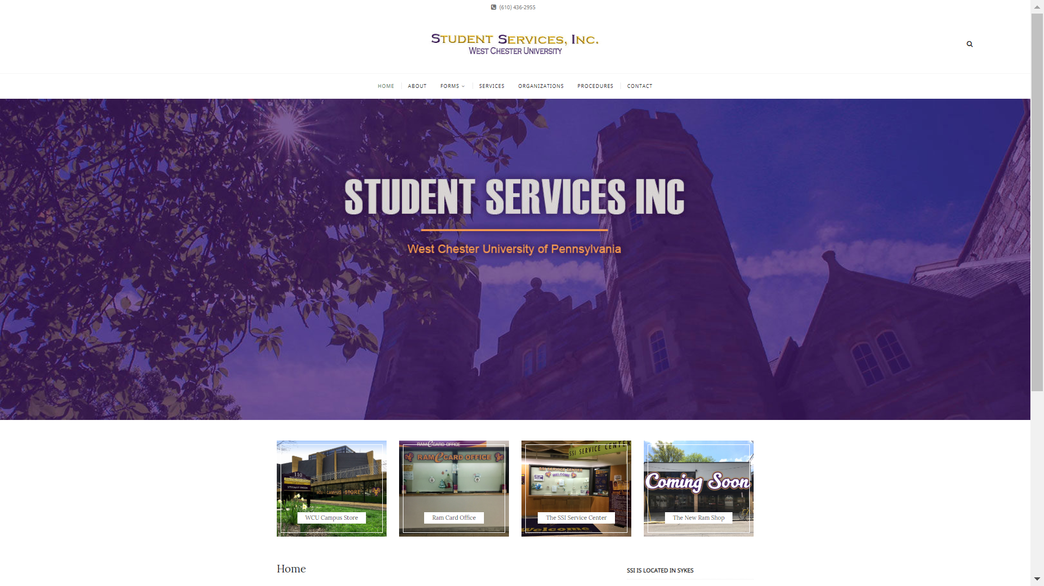
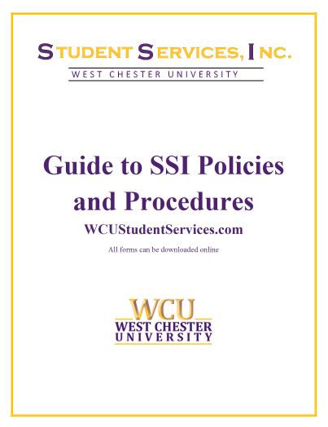
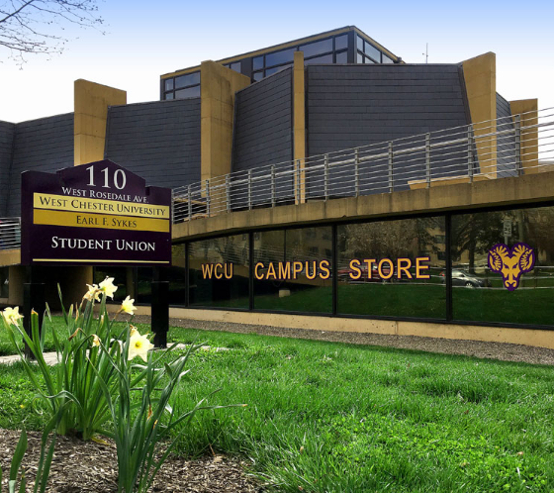
Student Services, Inc.
Important SSI Documents, Resources and Services:
SSI Policies and Procedures
SSI Website: wcustudentservices.com
SSI Documents
  Payment Voucher
  Deposit Slip
  Purchase Request Form
  Credit Card Request Form
Balance of Funds in SSI Accounts

Slide 34
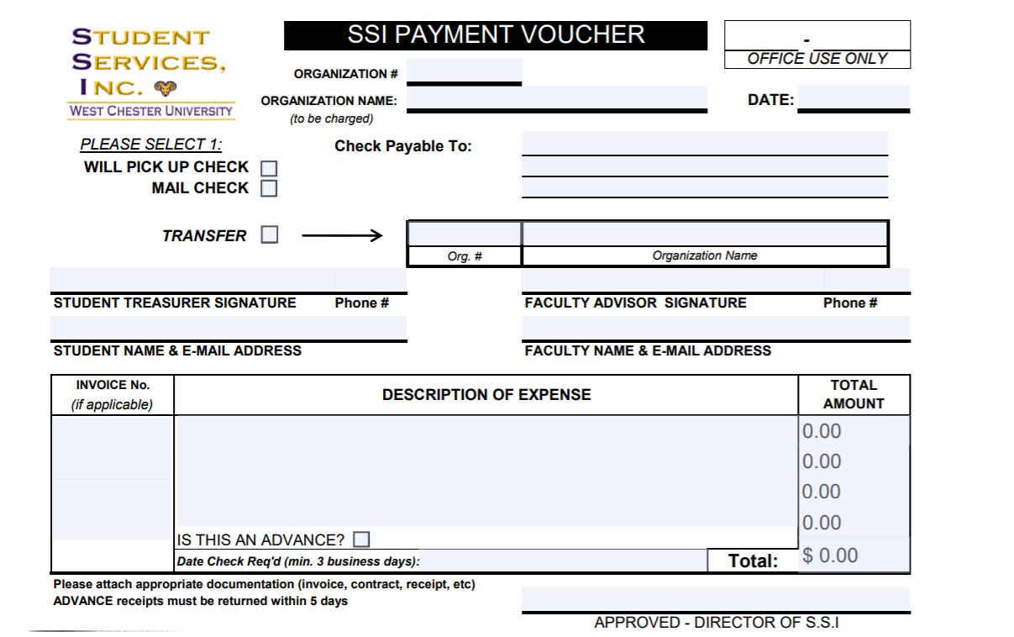
Payment Voucher
SSI Policies and Procedure Manual: Pages 4-6
A Payment Voucher is used by organizations to pay invoices, request reimbursement for expense, request advances and transfer funds to other SSI organization accounts.
When filling out a payment voucher for an invoice or request for reimbursement, be sure to include a copy of the invoice and/or a copy of a detailed receipt to show proof of purchase.

Slide 35
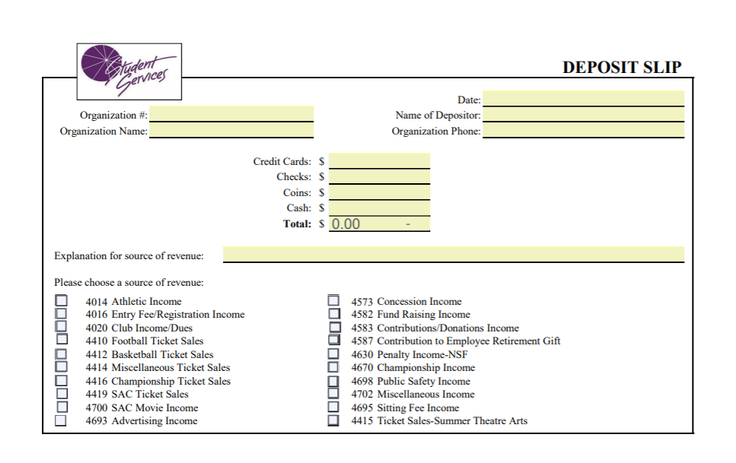
Deposit Slip
SSI Policies and Procedure Manual: Page 6
A Deposit Slip is used by organizations to deposit any funds received by said organization into their SSI account.
Deposit Slips are to be filled out and submitted to the SSI Service Center on the ground floor of Sykes Student Union.
Please allow up to a week to see the deposited funds appear on an updated organizational balance sheet.

Slide 36
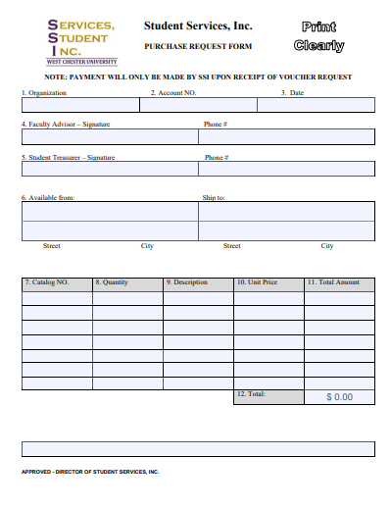
Purchase Request Form
SSI Policies and Procedure Manual: Pages 6-7
Occasionally, an organization will need to place an order for merchandise which will not be delivered until a later date, such as customized shirts or buttons. Instead of issuing a check before the merchandise is received, most vendors will accept a purchase order from SSI. A purchase order is essentially a promise to pay the vendor once the order has been received and is accepted by many vendors.

Slide 37
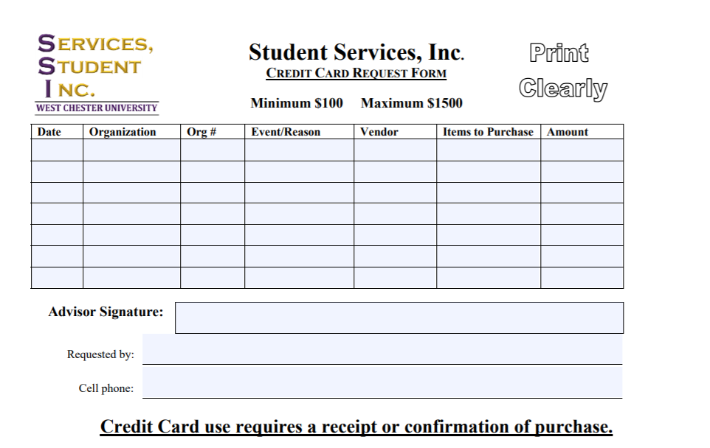
Credit Card Request Form
SSI Policies and Procedure Manual: Page 8
In order to use the SSI credit card to make purchases, organizations must fill out a Credit Card Request Form.
The SSI Credit Card Request Form must be submitted and approved before any student is approved to use the card.
Minimum amount to use the SSI Credit Card is $100.
Any purchase over $1,500 must be approved by the SSI Executive Director.
All purchases will be done in the SSI Business Office by a representative of the student organization. At no time can the SSI credit card leave the Business Office.

Slide 38
Balance of Funds in SSI Accounts .
SSI Policies and Procedure Manual: Page 7
As organizations that maintain an account with SSI, you are encouraged to obtain a financial report by visiting the SSI Business Office and requesting a printout. This report is also available in .pdf format and may be emailed to you upon request.

Slide 39

Question & Answer
Student Government Association:
Office: 213 Sykes Student Union
Office of Student Leadership and Involvement
Office: 238 Sykes Student Union
Student Services, Inc:
Office: 259 Sykes Student Union

